Slide 1
Object Detection Using YOLO and Image Emotion Analysis Using ResNet-50
By Ruparagunath

Slide 2
Introduction to Object Detection
Object detection is a crucial task in computer vision, enabling the identification and localization of objects within images and videos.
It involves classifying objects and determining their positions, crucial for applications in surveillance, autonomous vehicles, and more.
Modern object detection techniques leverage deep learning for improved accuracy and efficiency.

Slide 3
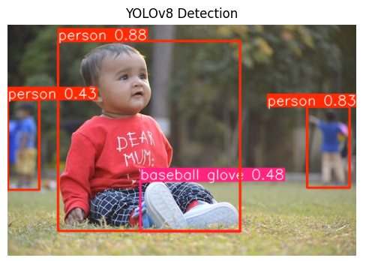
YOLO: You Only Look Once
YOLO (You Only Look Once) is a real-time object detection system known for its speed and accuracy.
Developed by Joseph Redmon et al. in 2015, YOLO transforms object detection into a single regression problem.
It predicts bounding boxes and class probabilities directly from the full image in one evaluation.

Slide 4
Advantages of YOLO
YOLO is significantly faster than traditional methods, processing images in real-time.
It uses a unique approach by looking at the whole image at once, providing global context.
YOLO's grid-based prediction and class probabilities enhance both speed and accuracy.

Slide 5
Applications of YOLO
YOLO is widely used in applications such as autonomous driving, real-time video analysis, and security systems.
Its ability to detect and classify multiple objects simultaneously makes it invaluable for dynamic environments.
YOLO has undergone multiple iterations, with the latest being YOLO v7, offering improved performance.

Slide 6
Introduction to Image Emotion Analysis
Image emotion analysis involves recognizing and categorizing emotions from facial expressions in images.
This task is essential for applications in marketing, user experience research, and mental health monitoring.
Deep learning models like ResNet-50 are at the forefront of emotion detection due to their robust feature extraction capabilities.

Slide 7
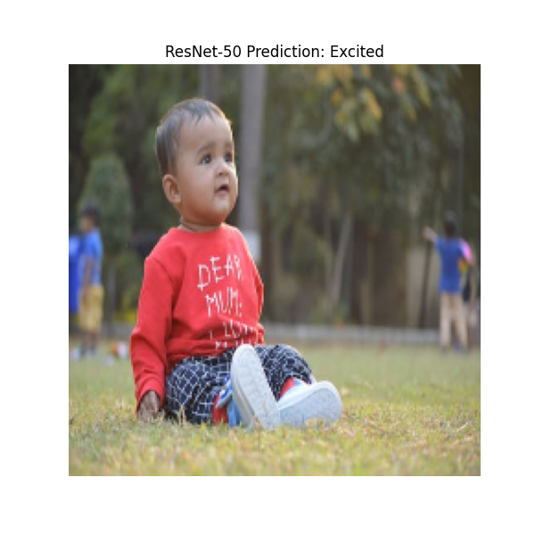
ResNet-50 for Emotion Detection
ResNet-50, a deep residual network, excels in extracting features for facial emotion recognition.
It utilizes convolutional layers to identify and classify emotions, such as excitement and sadness, from facial images.
The network's architecture enables it to handle complex image data efficiently, making it suitable for emotion detection.

Slide 8
Advantages of ResNet-50 in Emotion Analysis
ResNet-50's deep architecture allows it to capture intricate details in facial expressions.
It provides high accuracy in emotion classification by effectively learning features from large datasets.
The model is versatile, applicable to various domains requiring emotion analysis, such as entertainment and healthcare.

Slide 9
Applications of Emotion Analysis
Emotion detection is crucial in enhancing user interaction in applications like virtual assistants and social robots.
It aids in sentiment analysis, improving customer service by understanding user emotions.
Mental health applications benefit from emotion analysis by monitoring mood changes and providing timely interventions.

Slide 10
Conclusion
Both YOLO and ResNet-50 demonstrate the power of deep learning in solving complex computer vision tasks.
YOLO's speed and accuracy make it ideal for real-time detection, while ResNet-50 excels in detailed emotion analysis.
These technologies continue to evolve, offering new possibilities and applications in diverse fields.

Slide 11
References
[1] Wikipedia on YOLO
[2] GeeksforGeeks - Object Detection with YOLO
[3] V7 Labs - YOLO Object Detection
[4] ScienceDirect - Emotion Analysis with ResNet-50
[5] Kaggle - Facial Emotion Recognition using ResNet50

Slide 12
Nandri ! THANK YOU ! Arigato !

